Slide 1







Weighted Graphs
Every edge is labeled a numerical weight.
3
$$a$$
$$d$$
3
4
6
5
$$s$$
1
$$c$$
1
2
$$f$$
2
5
3
$$b$$
$$e$$
2
Assumption: No edge has negative weight.

Slide 2

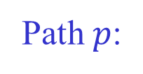






Length of a Path
The weight (length) of a path is the sum of the weights of its edges.
7 2 1 5
Path $p$:
$$a$$
$$b$$
$$c$$
$$d$$
$$e$$
Edge weights: $w(a, b)=7, w(b, c)=2, w(c, d)=1, w(d, e)=5$
Path weight $w(p) = 7+2+1+5 = 15$
A shortest path from vertex $u$ to vertex $v$ has the minimum
weight among all paths connecting $u$ to $v$.

Slide 3



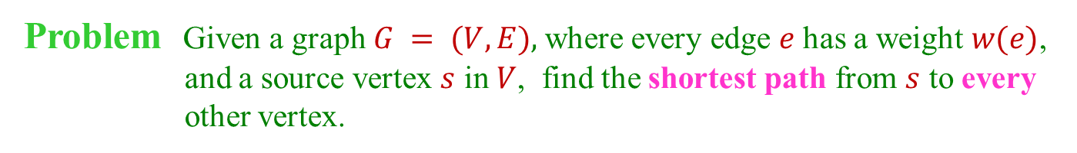


Single-Source Shortest Paths
Problem Given a graph $G = (V, E),$where every edge $e$ has a weight $w(e)$,
and a source vertex $s$ in $V$, find the shortest path from $s$ to every
other vertex.
3
$$a$$
$$d$$
3
4
6
source
5
$$s$$
1
$$c$$
1
2
$$f$$
2
5
3
$$b$$
$$e$$
2
$$s a b c d e f$$
weight $0 3 4 6 6 6 9$
path $s$ $s$-$a$ $s$-$a$-$b$ $s$-$a$-$b$-$c$ $s$-$a$-$d$ $s$-$a$-$b$-$e$ $s$-$a$-$b$-$e$-$f$

Slide 4
Applications
Transportation (shortest route from Ames to Phoenix?)
Network routing (how to direct packets to a destination across a network?)
Telecommunications
Speech interpretation (best interpretation of a spoken sentence)
Robot path planning
Medical imaging
Building block for network algorithms
...

Slide 5

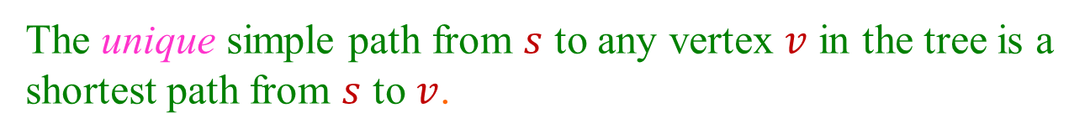
Shortest-Paths Tree
The unique simple path from $s$ to any vertex $v$ in the tree is a
shortest path from $s$ to $v$.
3
$$a$$
$$d$$
3
$$s$$
1
$$c$$
$$f$$
2
$$e$$
3
$$b$$
2
The vertices in the tree are exactly those reachable from $s$ in $G$.
Similar to the breadth-first tree (where all edges have weight 1).

Slide 6
Unreachable Vertices
a
b
4
3
7
3
4
h
i
s
6
d
g
2
c
∞
∞
5
11
8
source
0
5
5
3
-8
3
2
e
3
f
∞
2
5
7
j
-6
unreachable from s

Slide 7





No Cycle in a Shortest Path
A shortest path cannot contain a cycle because otherwise
the removal of such a cycle would reduce the path weight.
$$w$$
$$u$$
$$v$$
$$y$$
$$x$$
Any zero-weight cycle in a shortest path can be removed.
So we only need to consider shortest path of $≤ |V| – 1$edges.

Slide 8

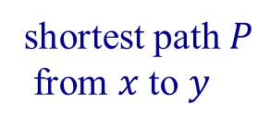




Subpath Must Be Shortest
Any subpath of a shortest path is the shortest of all paths between
the two intermediate vertices.
x
Below is the reasoning:

